Slide 1

Machine Learning untuk Aplikasi Geospasial
February 20, 2021
Geospatial Data Science Crash Course
Part 2 of 3
Dany Laksono
Departemen Teknik Geodesi UGM

Slide 2

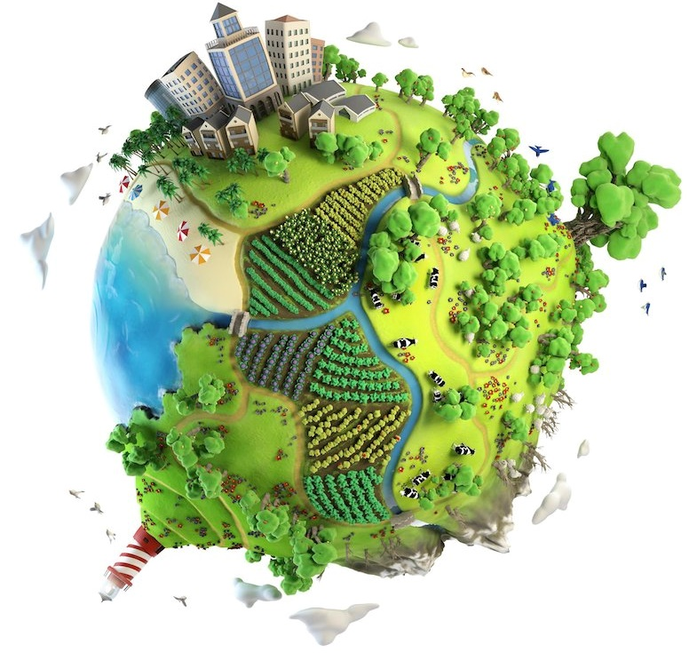
Machine Learning untuk Aplikasi Geospasial
How Machines Learn
Machine Learning untuk Aplikasi Geospasial
Algoritma-algoritma Machine Learning
Perangkat untuk Machine Learning

Slide 3
Tentang Pelatihan Ini
Intro to Data Science
Machine Learning
Deep Learning

Slide 4

How Machines Learn
Notes:
https://www.python.org/dev/peps/pep-0008/

Slide 5

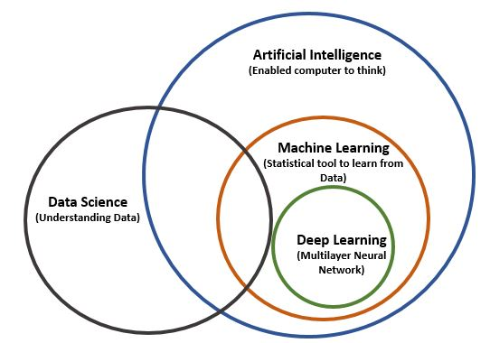
AI, ML dan Deep Learning
Machine Learning is one of the algorithms in AI
Deep Learning is a branch of ML which deals with deeply layered network

Slide 6
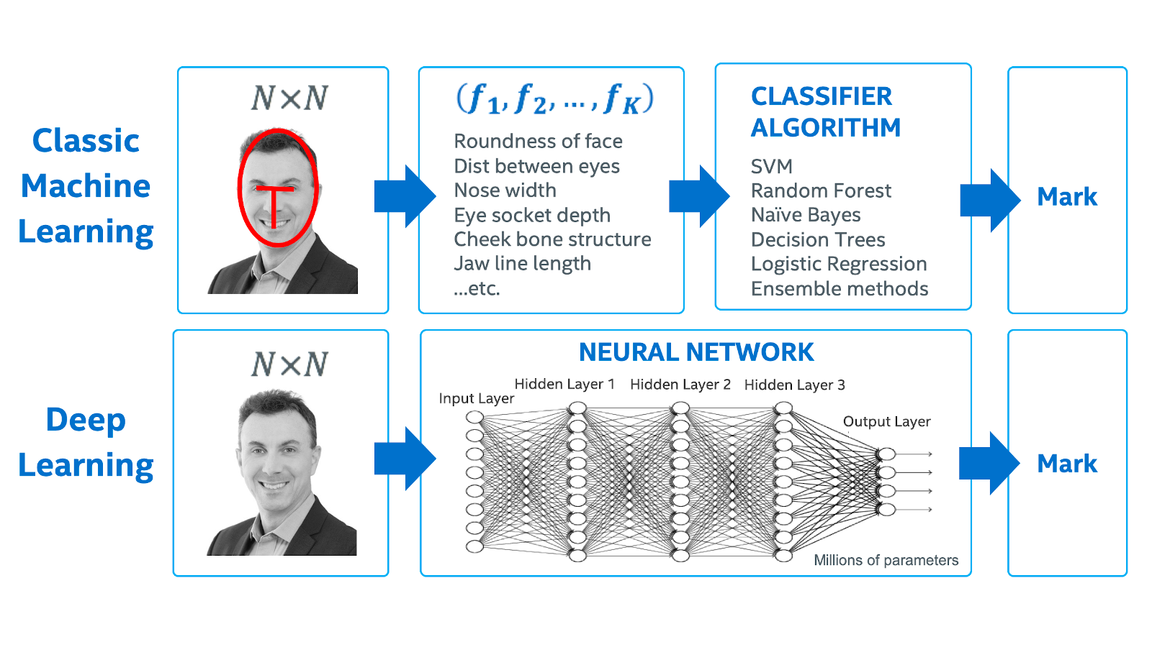
Deep Learning: Our Focus Next Week
AI, ML dan Deep Learning
Deep Learning is a branch of ML which deals with deeply layered network
Notes:
https://www.intel.co.id/content/www/id/id/artificial-intelligence/posts/difference-between-ai-machine-learning-deep-learning.html

Slide 7

Data Science dan Machine Learning
Machine Learning merupakan perangkat yang sesuai untuk pengolahan data Big DATA
Mesin dapat di’ajari’ untuk menemukan pola pada data, membuat prediksi, dan seterusnya untuk data dalam jumlah yang sangat besar
Notes:
https://www.python.org/dev/peps/pep-0008/

Slide 8
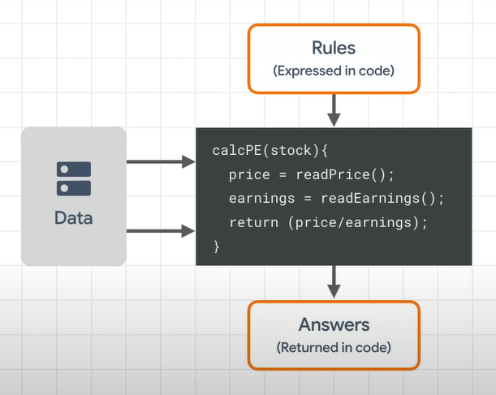

How to make Machine Learns?
Pada pemrograman tradisional, programmer membuat serangkaian aturan (rules) dalam bentuk program
Program kemudian mengolah data, dan berdasarkan aturan tersebut, memberikan hasil (answers)
@Google

Slide 9
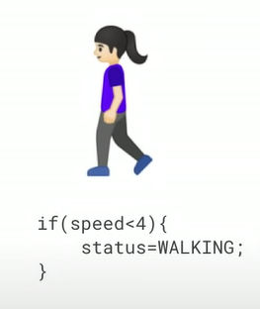
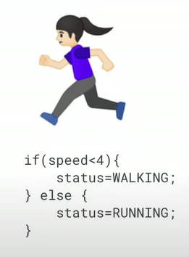
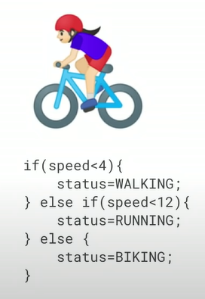
How to make Machine Learns?
In traditional computer programming, computers only solve problems defined by the programmer’s rules
@Google

Slide 10
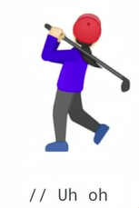
How to make Machine Learns?
In machine learning, computers need to solve problems on new data, never seen before by the algorithms
@Google

Slide 11

How to make Machine Learns?
Jika Anda diminta untuk membuat program yang dapat bermain catur, bagaimana Anda akan merancangnya?
Number of Possibilities:
The Shannon Number (10¹²⁰)

Slide 12
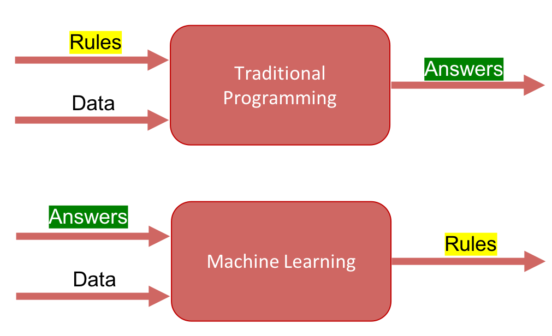
How to make Machine Learns?
“Machine Learning is the field of study that gives computers the ability to learn without being explicitly programmed”
--Arthur Samuel
f(x)
Notes:
https://www.python.org/dev/peps/pep-0008/

Slide 13
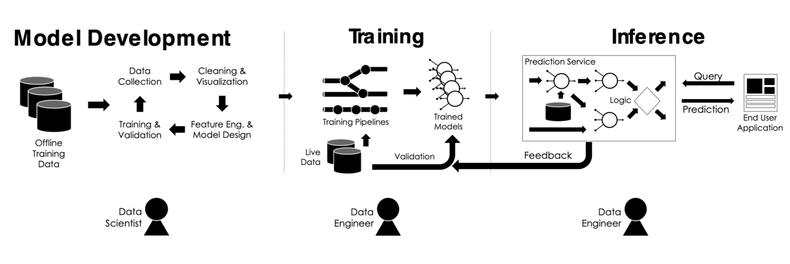
Machine Learning Lifecycle
@juyang.co
Training is the process where an algorithm uses optimization techniques to find the best set of model weights
Notes:
http://www.juyang.co/machine-learning-lifecycle/

Slide 14
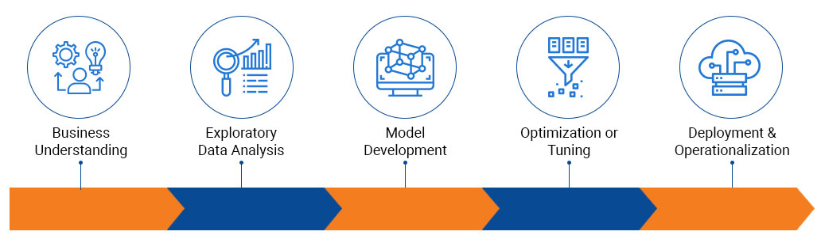
Machine Learning Lifecycle
Model weights is actually just numbers, which we could tune to make predictions
@saviantconsulting
Notes:
https://www.saviantconsulting.com/images/blog/machine-learning-development-lifecycle.jpg

Slide 15

Machine Learning untuk Aplikasi Geospasial
Notes:
Image sources:
https://medium.com/@northof41/what-really-is-the-difference-between-ar-mr-vr-xr-35bed1da1a4e

Slide 16
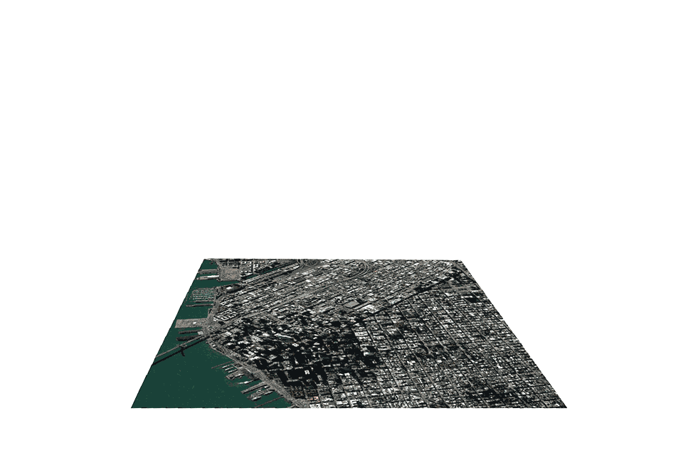
Sebagian besar Data Spasial memiliki sifat-sifat BIG DATA
Analisis geospasial seringkali merupakan proses yang melibatkan algoritma yang jelas
Teknik-teknik machine learning telah digunakan sejak lama di bidang geospasial
Munculnya jenis data spasial baru dari metode akuisisi data yang semakin beragam: Point Cloud, SAR, Social Media, Mobile phone data, etc.
Berkembangnya kebutuhan baru akan data spasial, seperti Self-Driving Cars dan Augmented/Virtual Reality
Machine Learning untuk Aplikasi Geospasial

Slide 17
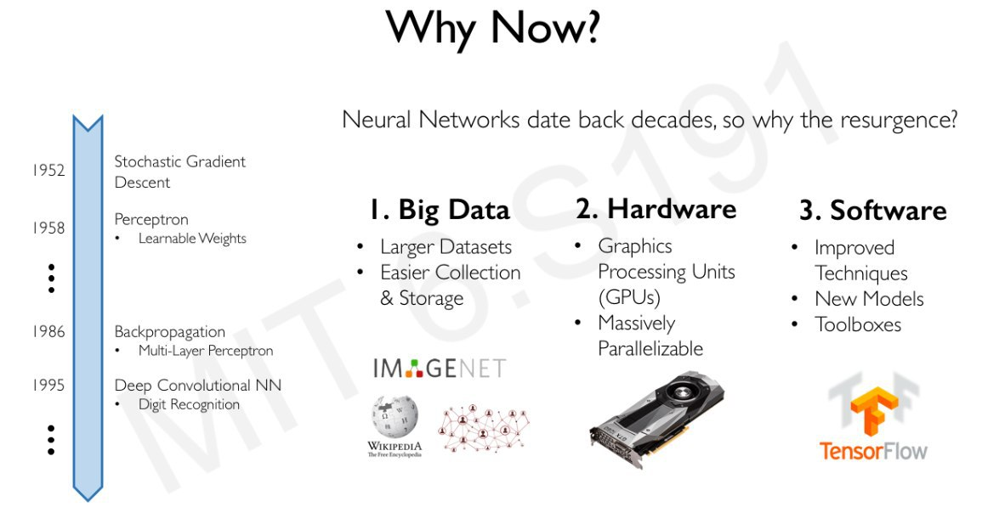

Slide 18
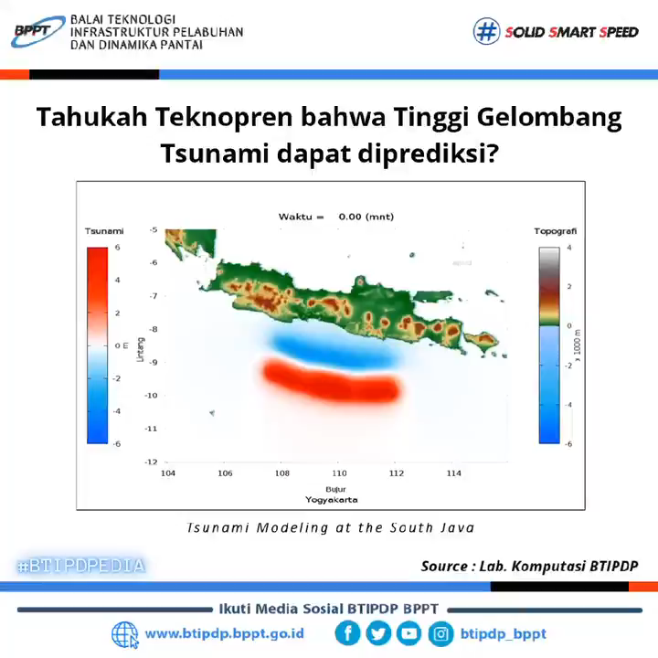
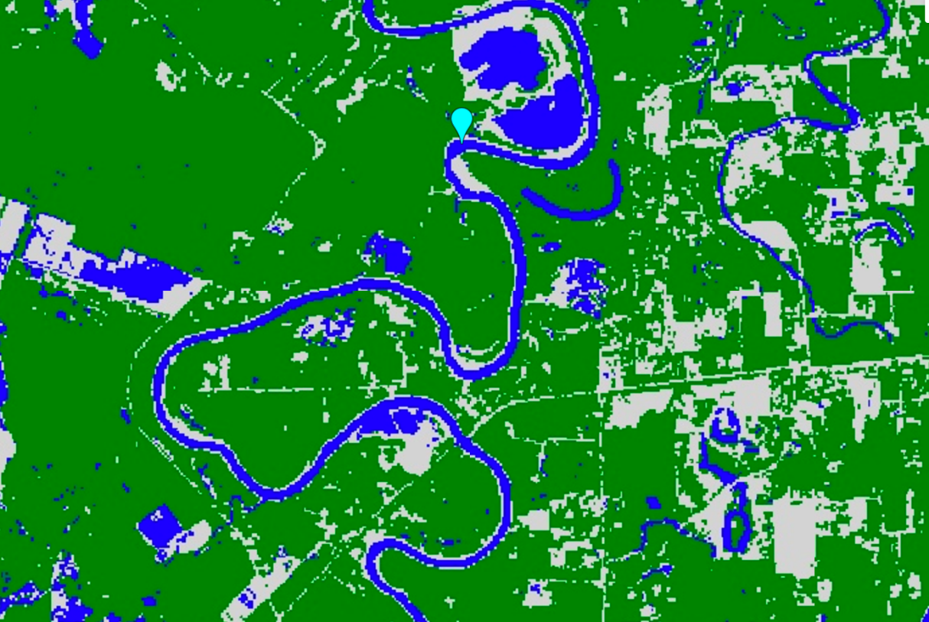
Machine Learning untuk Aplikasi Geospasial
Klasifikasi Land Use
Geosimulations

Slide 19
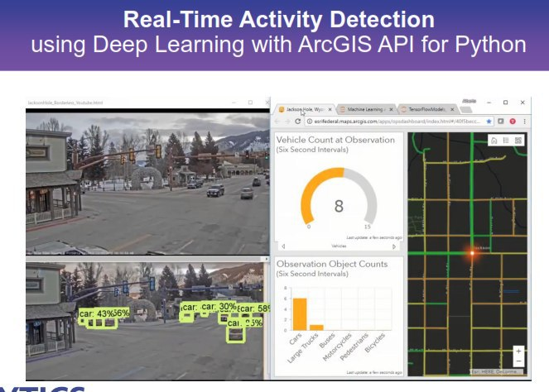
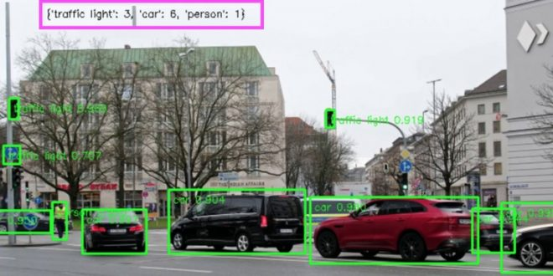
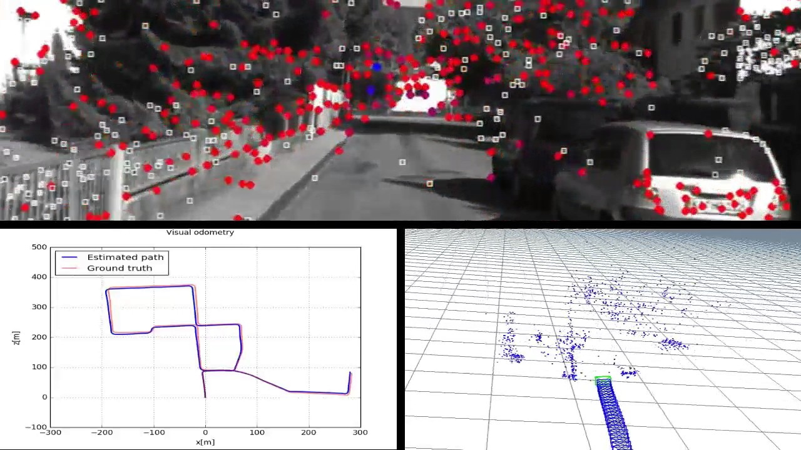
Machine Learning untuk Aplikasi Geospasial
Object Detection & Counting
Visual Odometry

Slide 20
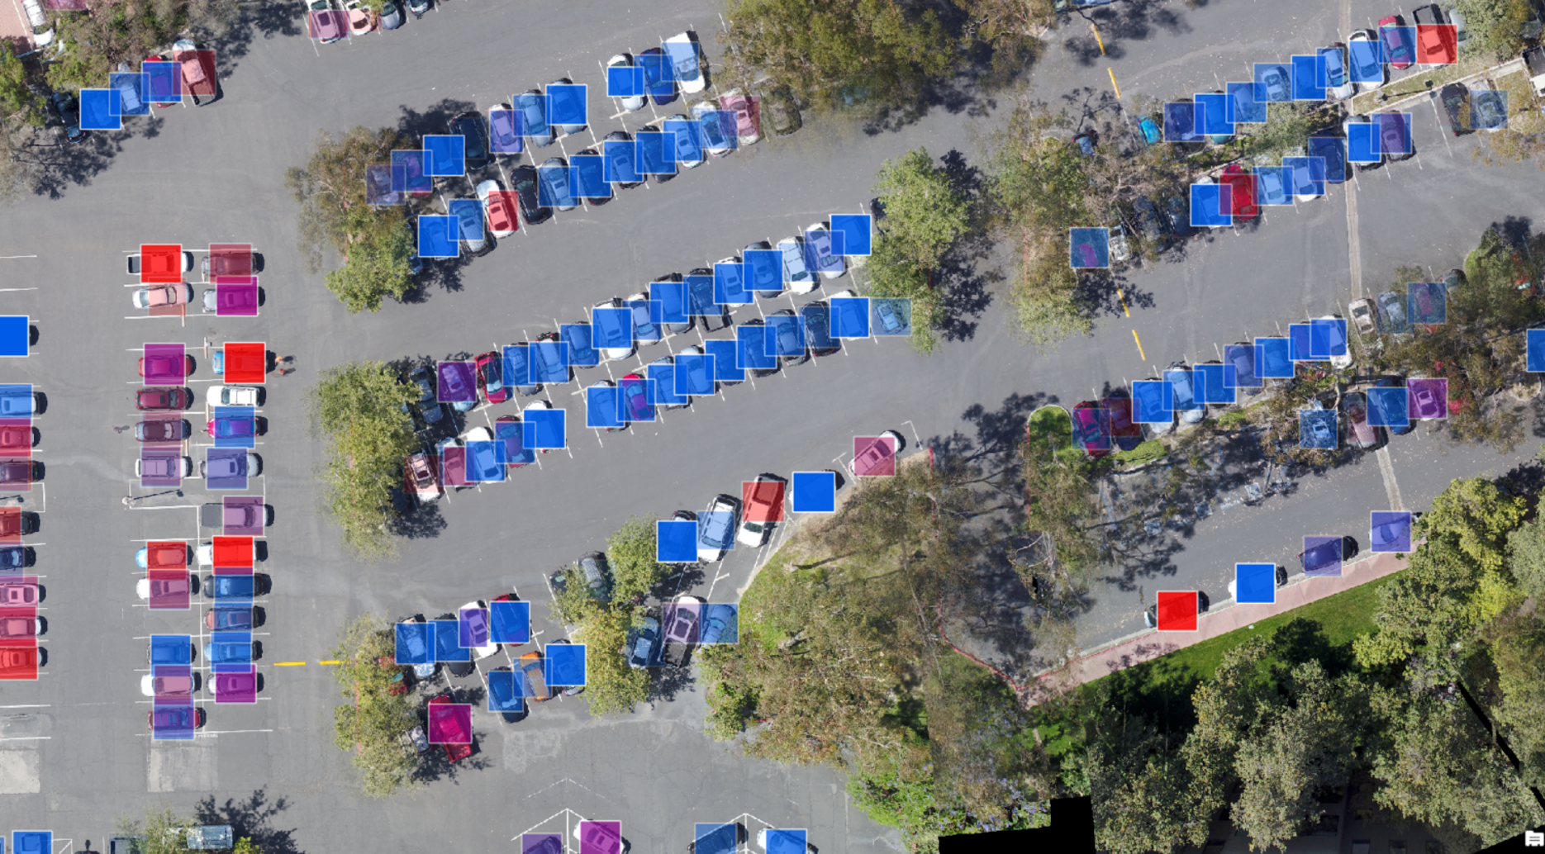
Machine Learning untuk Aplikasi Geospasial

Slide 21
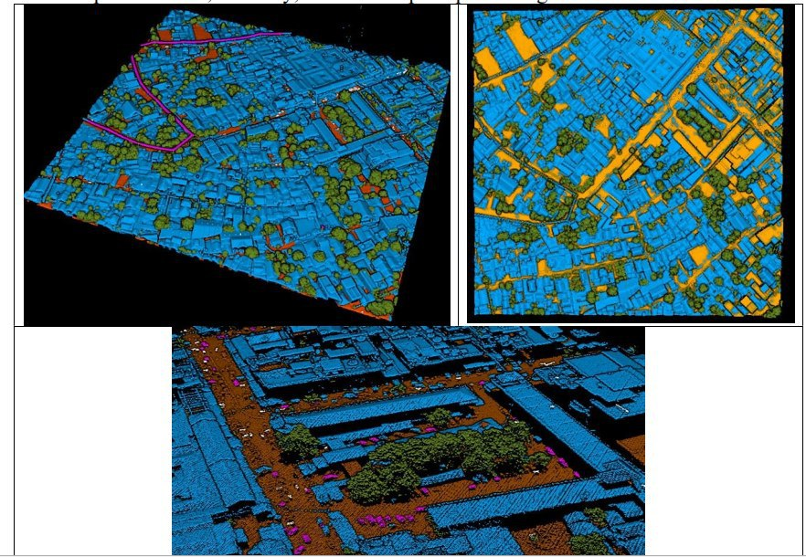
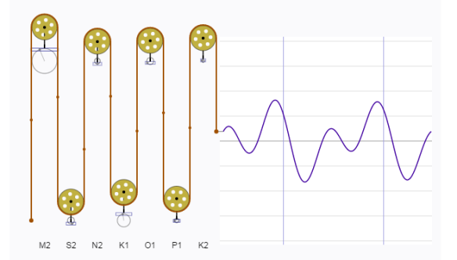
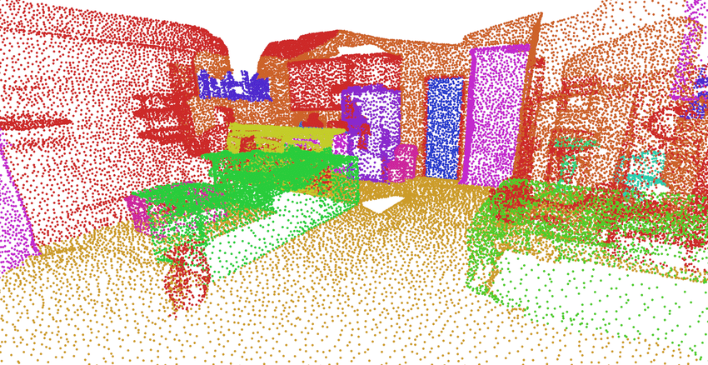
Machine Learning untuk Aplikasi Geospasial
Point-cloud Auto-classifications
Tide Predictions

Slide 22
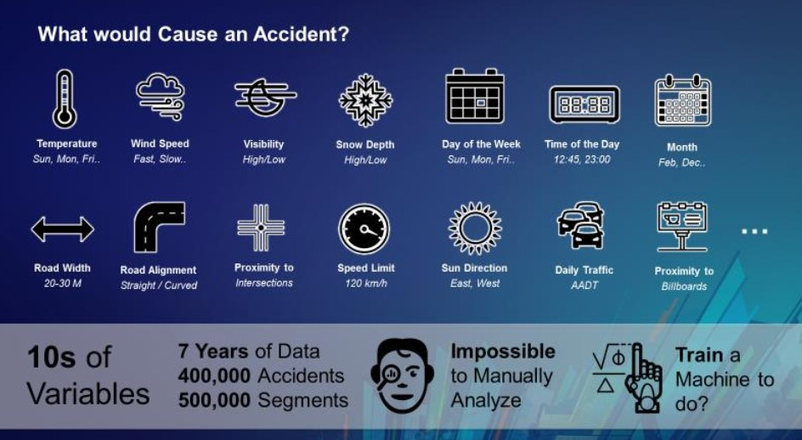
Machine Learning untuk Aplikasi Geospasial
Self-driving Cars

Slide 23
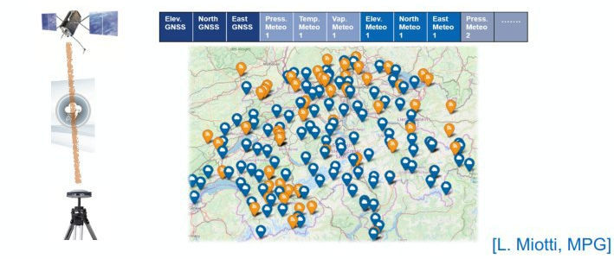
Machine Learning untuk Aplikasi Geospasial
Basically, we could implement ML/DL on any imaginable scenarios
As long as we have DATA, we could devise Machine Learning to derive Rules, and subsequently, Answes
Tropospheric Path Delay

Slide 24
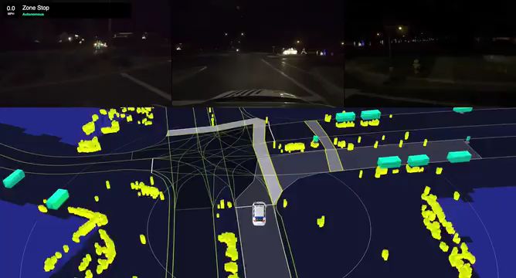
Machine Learning untuk Aplikasi Geospasial
Self-driving Cars

Slide 25
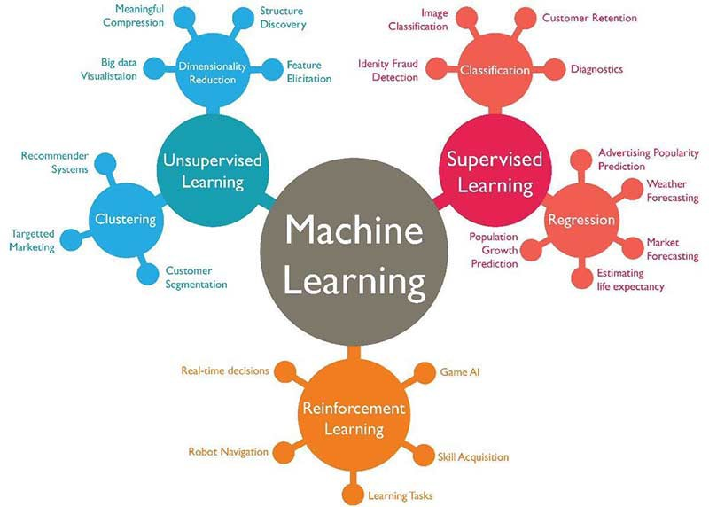
Algoritma-algoritma Machine Learning

Slide 26
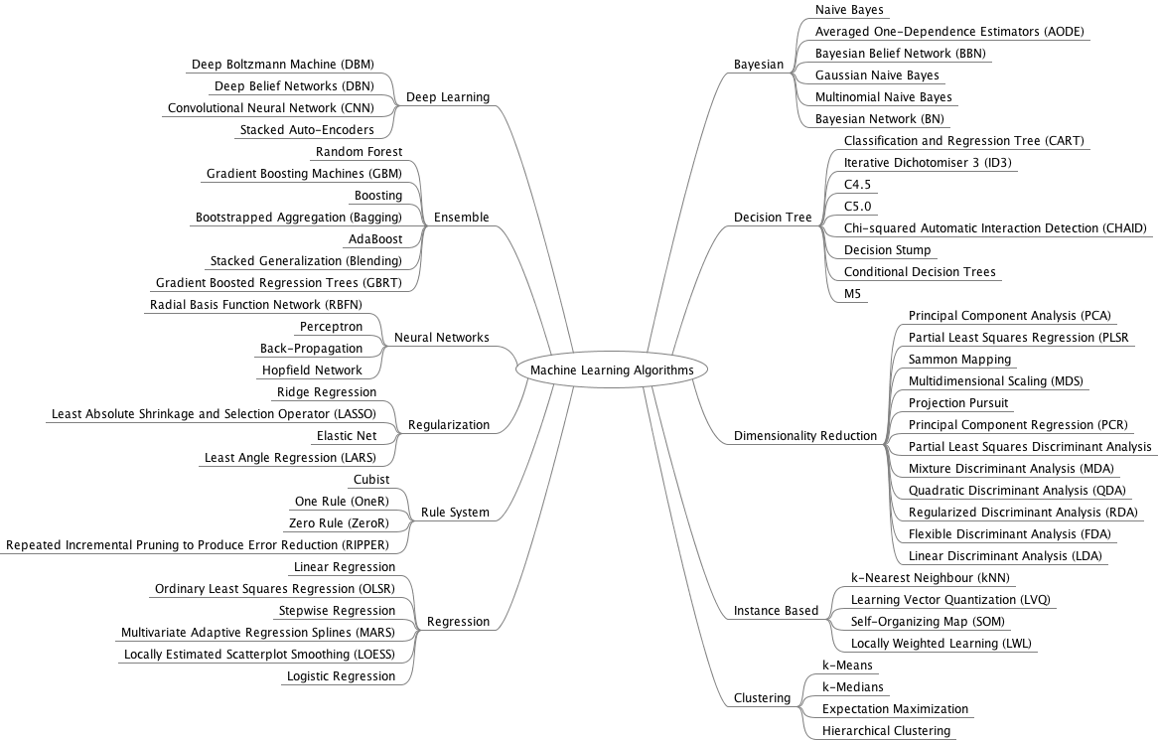
Algoritma-algoritma Machine Learning

Slide 27
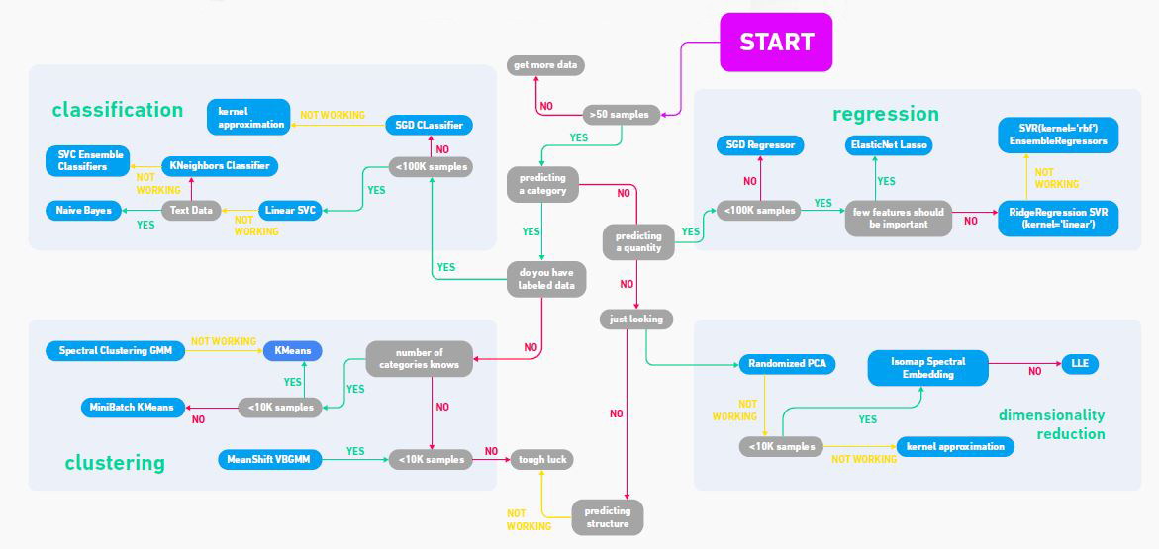
Algoritma-algoritma Machine Learning

Slide 28
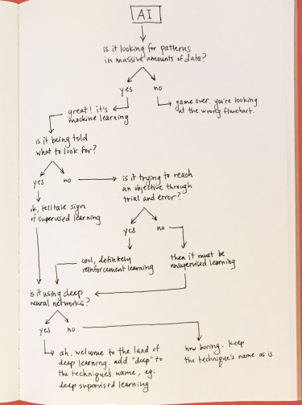
Algoritma-algoritma Machine Learning
How to Choose Which Machine Learning Algorithm to use?

Slide 29
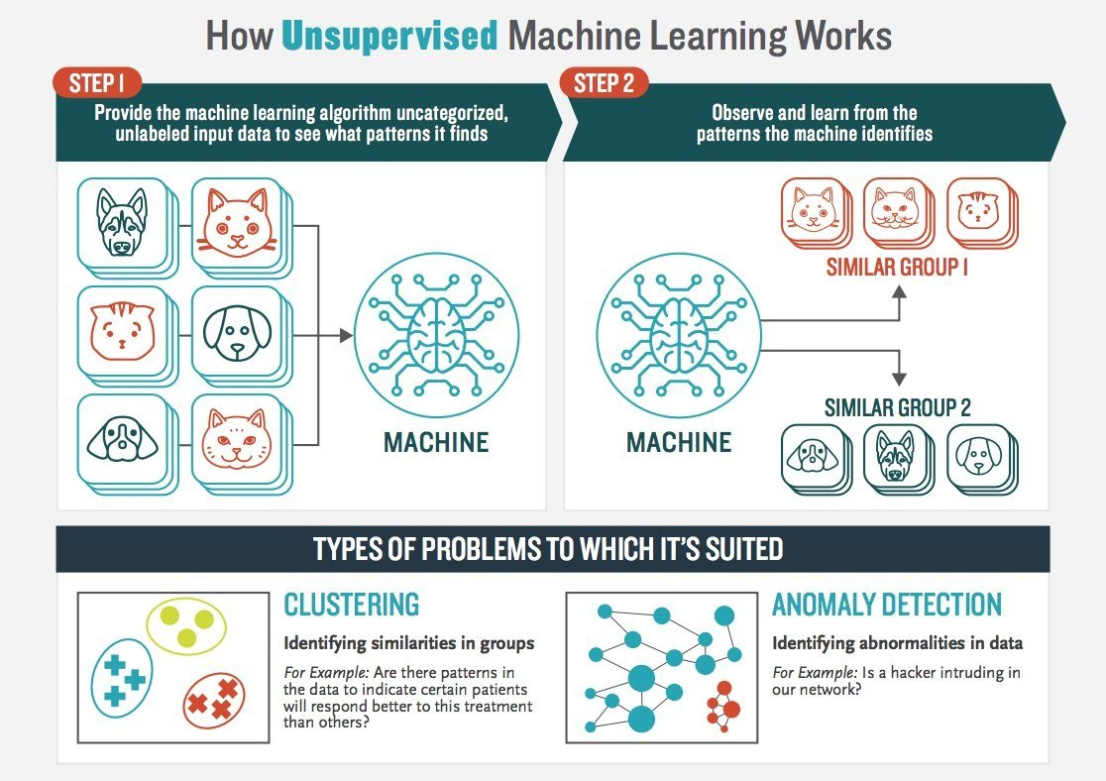
Unsupervised Machine Learning
Clustering
A clustering problem is where you want to discover the inherent groupings in the data, such as grouping customers by purchasing behavior.
Association
An association rule learning problem is where you want to discover rules that describe large portions of your data, such as people that buy X also tend to buy Y.

Slide 30
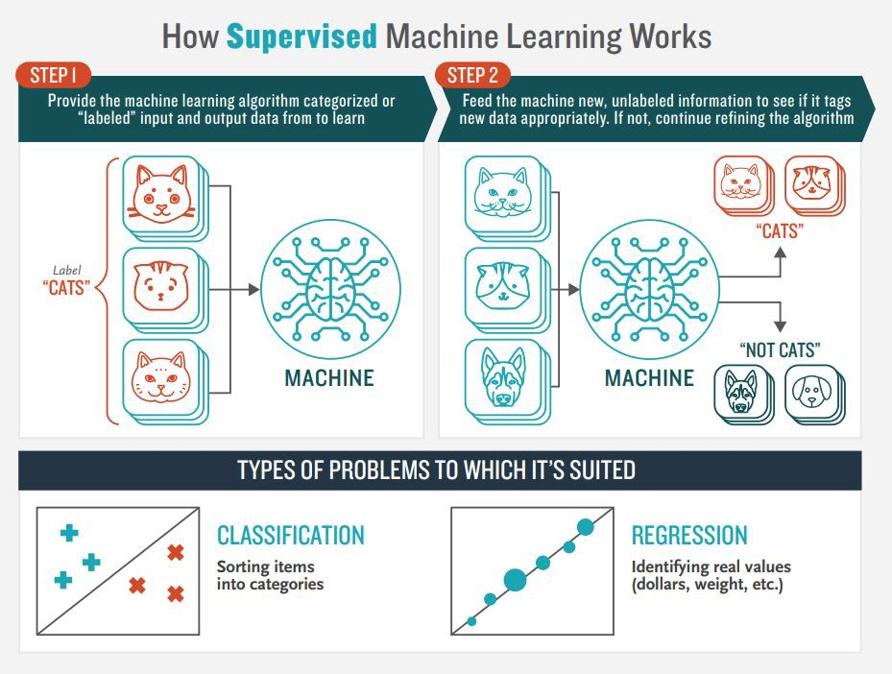
Supervised Machine Learning
Classification
A classification problem is when the output variable is a category, such as “red” or “blue” or “disease” and “no disease”.
Regression
A regression problem is when the output variable is a real value, such as “dollars” or “weight”.
Notes:
https://www.python.org/dev/peps/pep-0008/

Slide 31
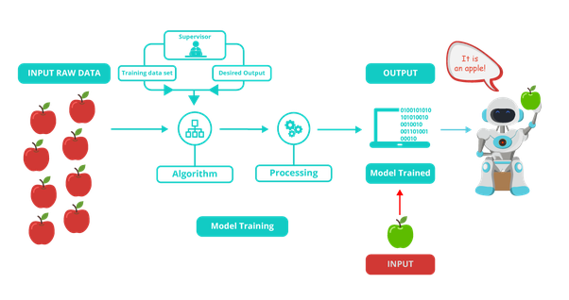
Supervised Machine Learning
Notes:
https://www.python.org/dev/peps/pep-0008/

Slide 32
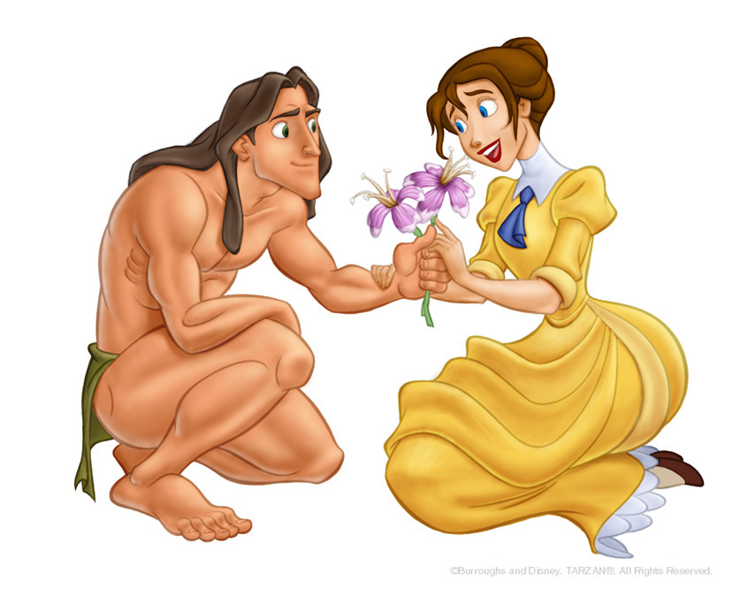

Reinforcement Machine Learning
Why is this Reinforcement Learning?

Slide 33
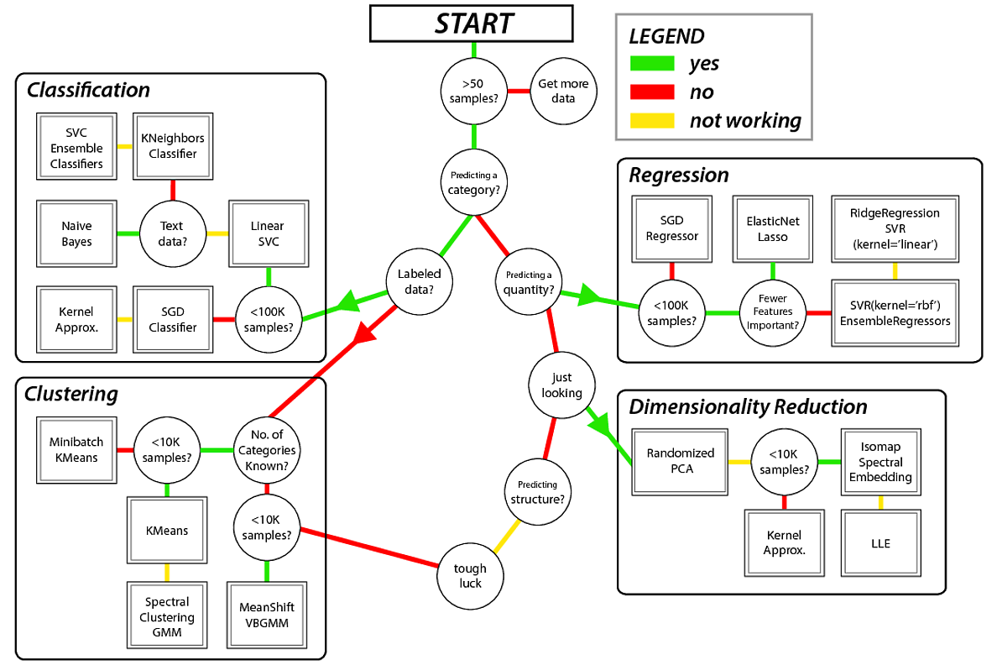
Simplified Machine Learning
Algorithm Selection
Notes:
https://www.python.org/dev/peps/pep-0008/

Slide 34
Perangkat untuk Machine Learning
Notes:
Image sources:
https://medium.com/@northof41/what-really-is-the-difference-between-ar-mr-vr-xr-35bed1da1a4e

Slide 35
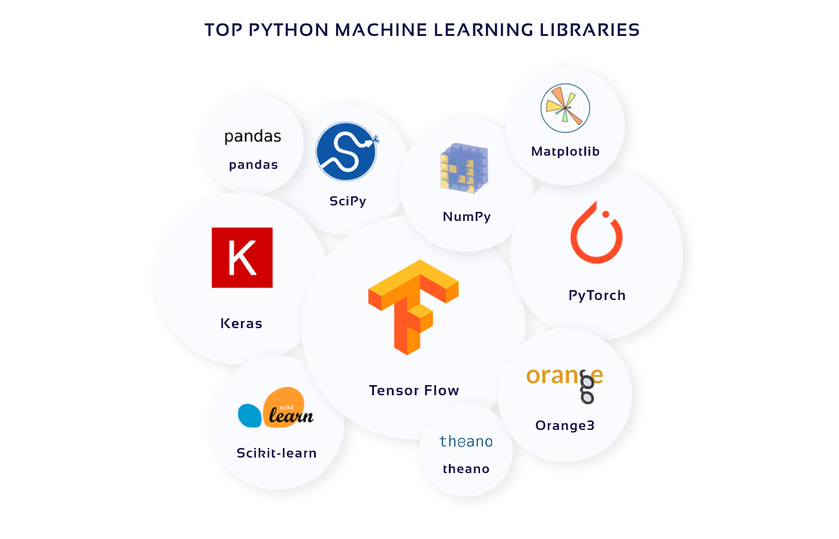

Slide 36
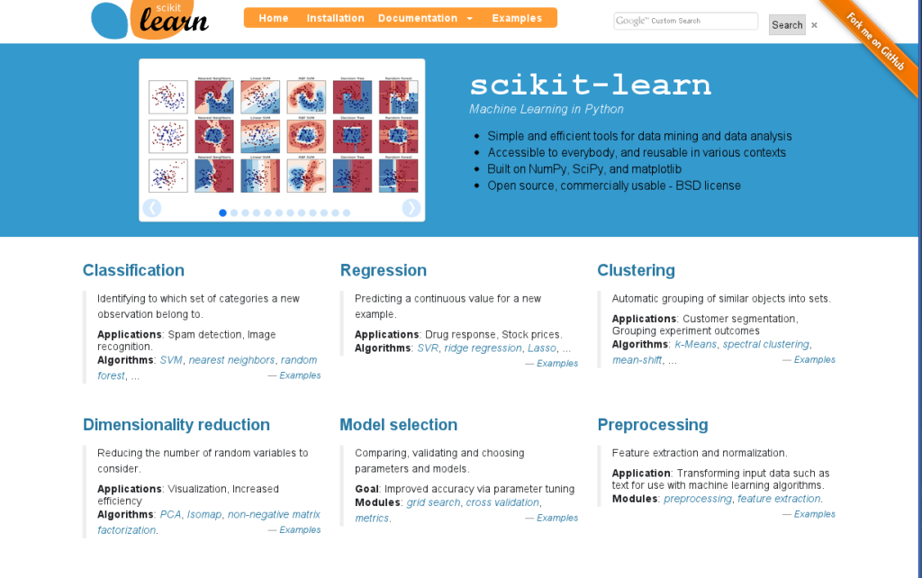
Notes:
https://machinelearningmastery.com/a-gentle-introduction-to-scikit-learn-a-python-machine-learning-library/v

Slide 37


Slide 38
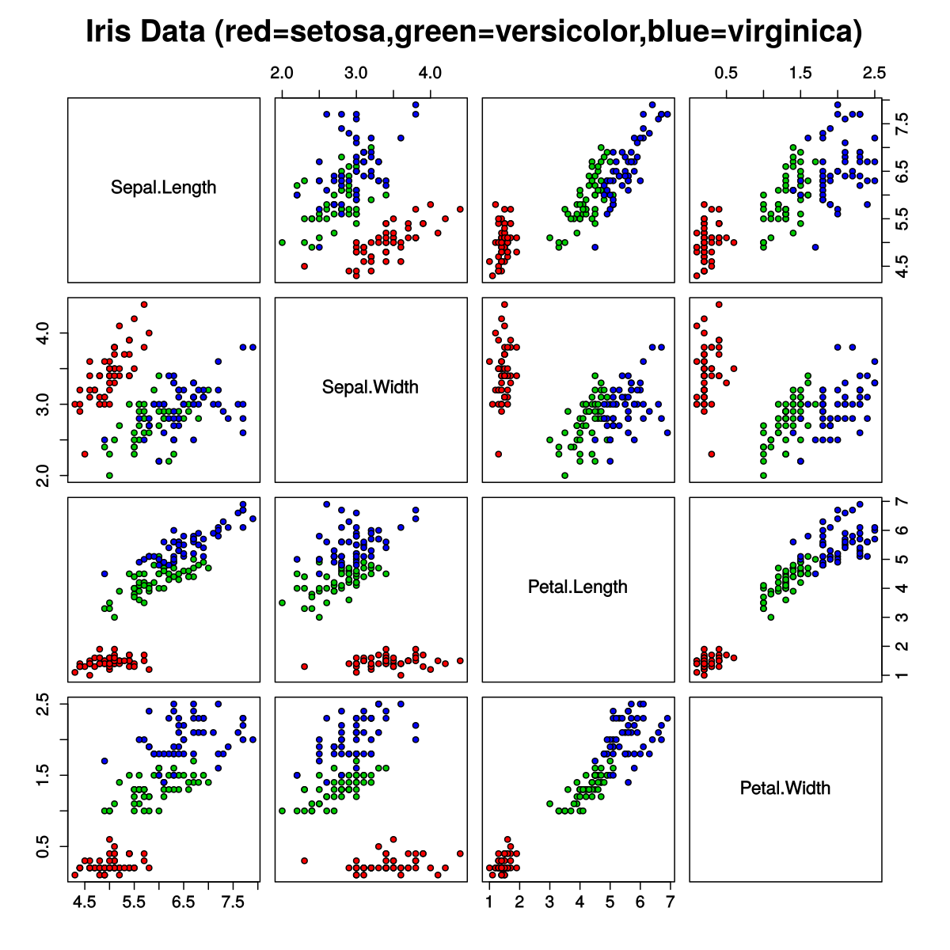
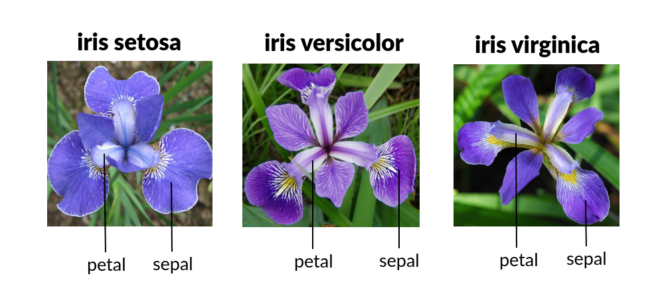
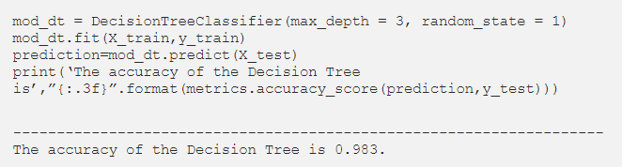
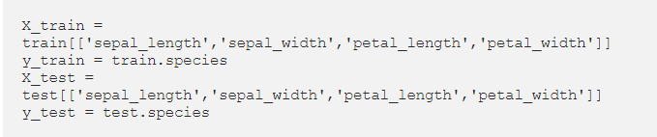
Reinforcement Machine Learning
Pisahkan data menjadi 2: training dan test data
Buat model (menggunakan Classifier untuk supervised learning)
Lakukan prediksi
Uji hasil prediksi

Slide 39
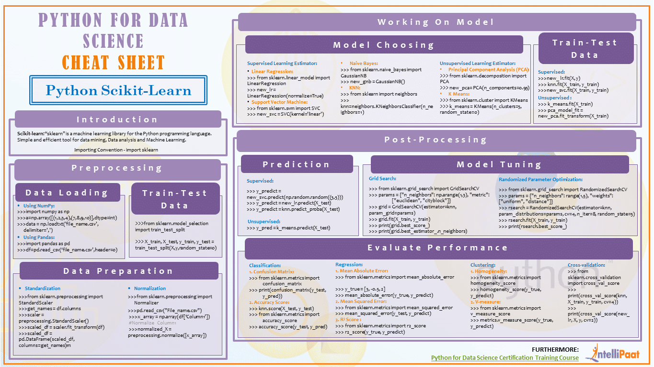

Slide 40
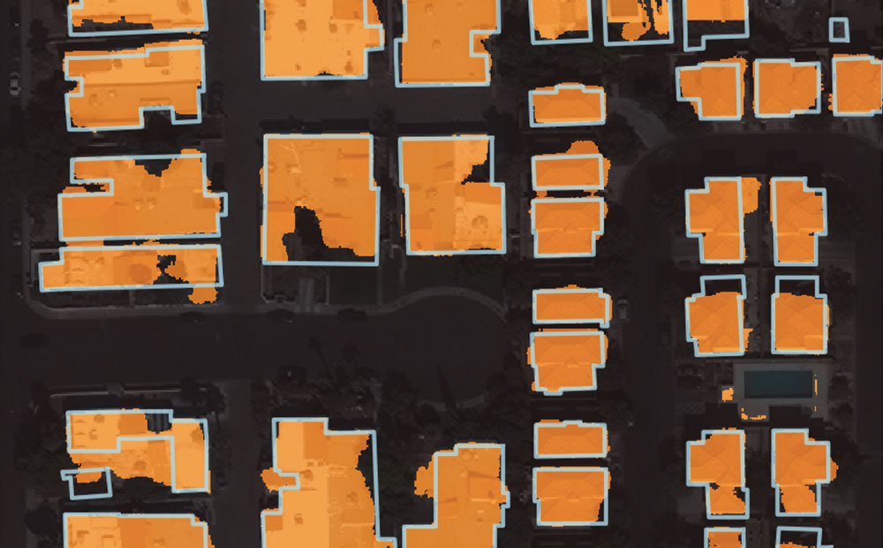
asda
NOISE in Labelling Training Data
Notes:
Image sources:
https://medium.com/@northof41/what-really-is-the-difference-between-ar-mr-vr-xr-35bed1da1a4e

Slide 41
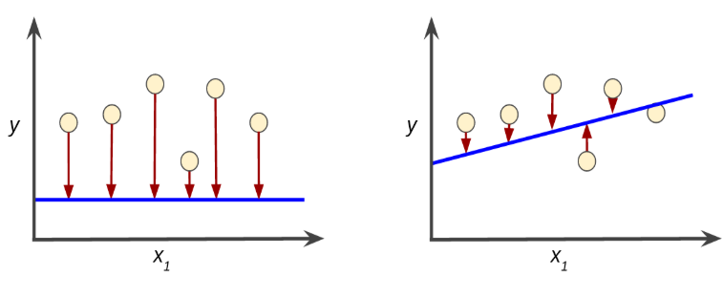
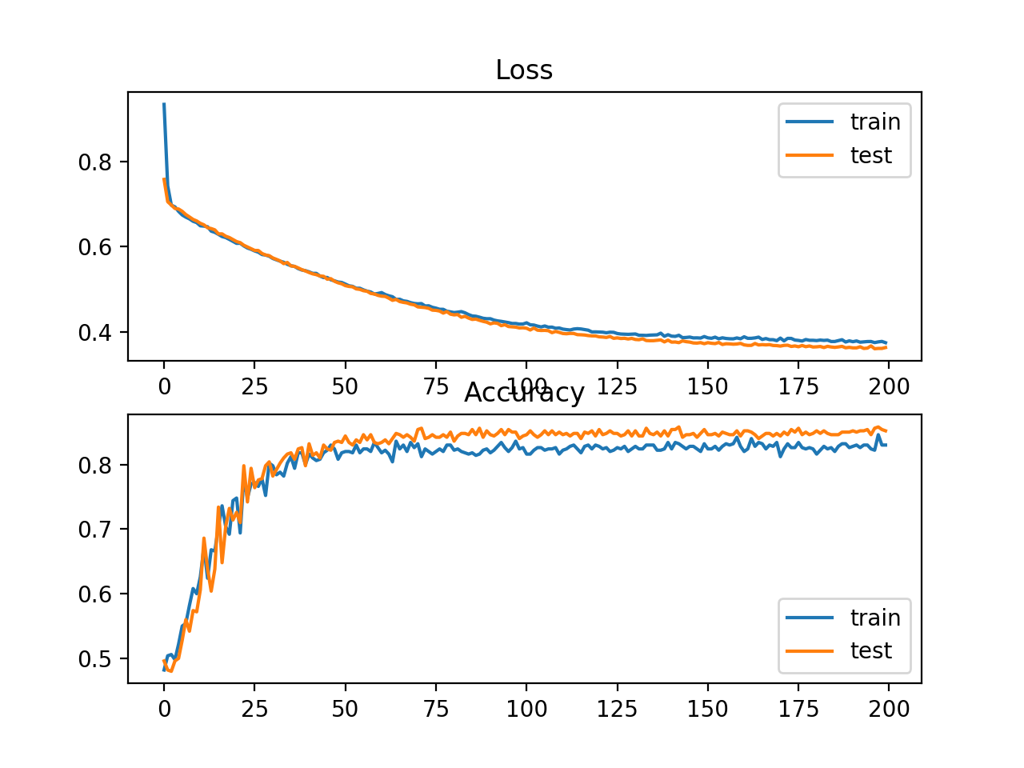
Uji Akurasi Hasil Machine Learning
Training a model simply means learning (determining) good values for all the weights and the bias from labeled examples.
Loss is the result of a bad prediction. A loss is a number indicating how bad the model's prediction was on a single example.
If the model's prediction is perfect, the loss is zero; otherwise, the loss is greater. The goal of training a model is to find a set of weights and biases that have low loss, on average, across all examples
Notes:
Image sources:
https://medium.com/@northof41/what-really-is-the-difference-between-ar-mr-vr-xr-35bed1da1a4e

Slide 42
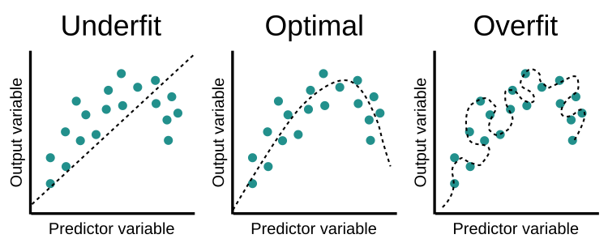
Uji Akurasi Hasil Machine Learning
training loss >> validation loss
training loss << validation loss
Notes:
Image sources:
https://medium.com/@northof41/what-really-is-the-difference-between-ar-mr-vr-xr-35bed1da1a4e

Slide 43
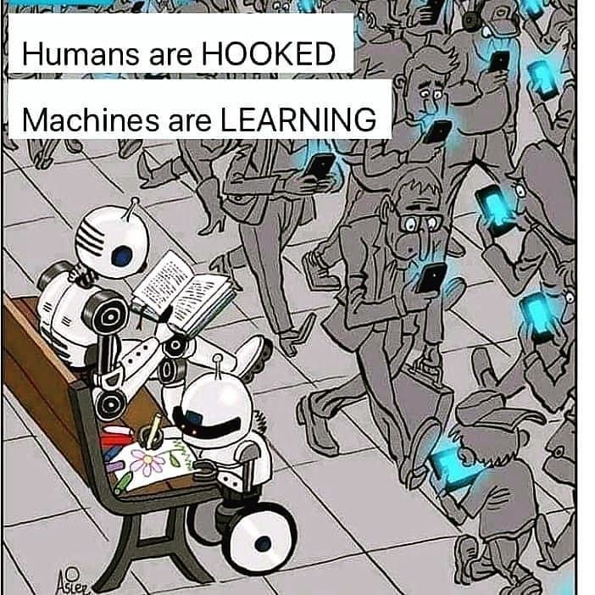
Questions?

Slide 44

TERIMA KASIH

